Slide 1
Chapters 12 and 13
We have skipped chapters 12 and 13 that go through Van der Waals type equations of state (the δ (del) solubility parameter)and group contribution methods where we consider chemical groups for each mixture molecule and add up their contribution to miscibility through a term like the δ -solubility parameter.
We don’t have time to go through chapters 12 and 13, though you may find them useful and interesting to read in the future. When you use Aspen or ChemCAD you can return to read about these more complex equations of state.
At this point we need to recognize the names of different models and be able to use the equations and approaches to estimate solubility and separation problems. The specific functions you will most use will be limited to one equation for specific fields for instance, the Flory-Huggins equation for polymers and UNIFAC for petrochemicals. So you don’t need to know all of the equations. Generally being able to pickup the different equations and apply them to problems is of use and we will do that in Chapter 14.

Slide 2
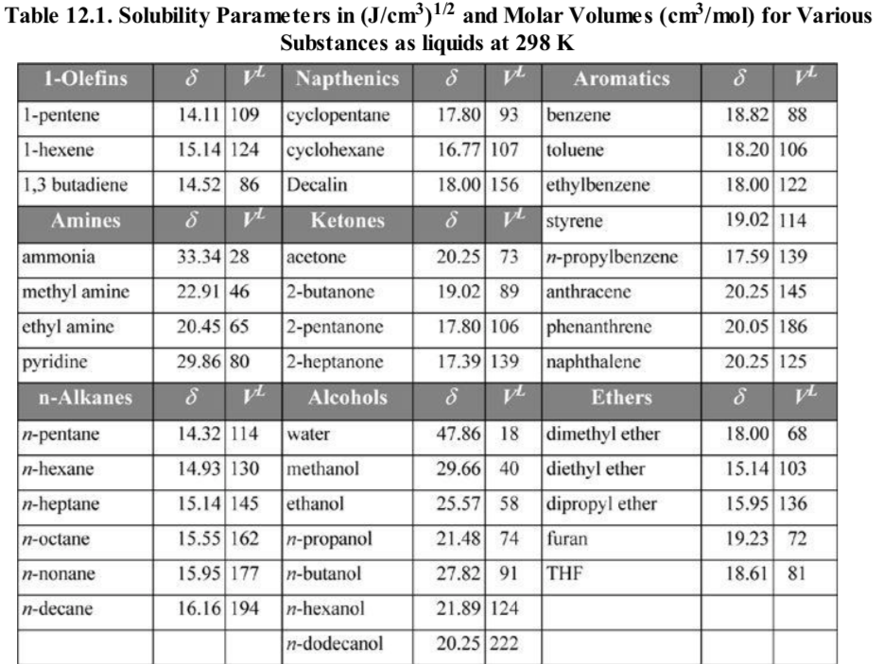



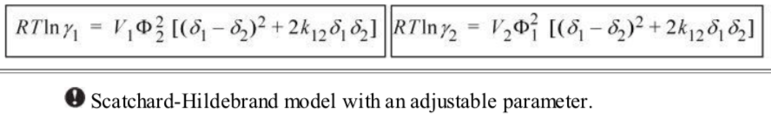

Slide 3
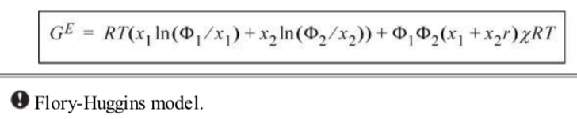


G/RT = x₁/N₁ ln(x₁) + x₂/N₂ ln(x₂) + x₁ x₂ χ₁₂

Slide 4
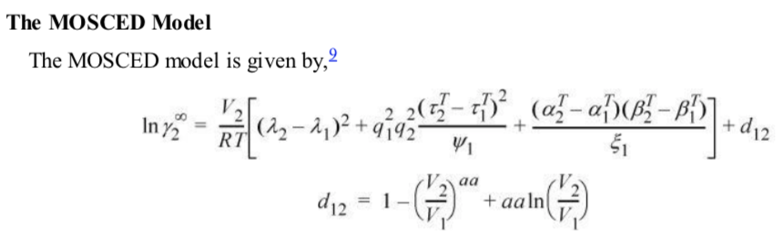
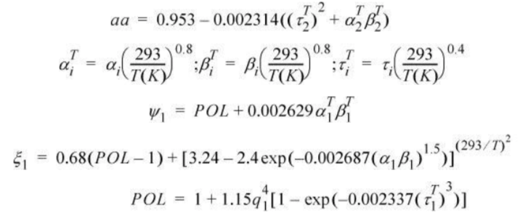

Slide 5
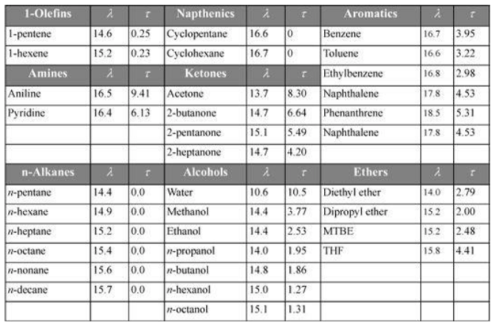

Slide 6
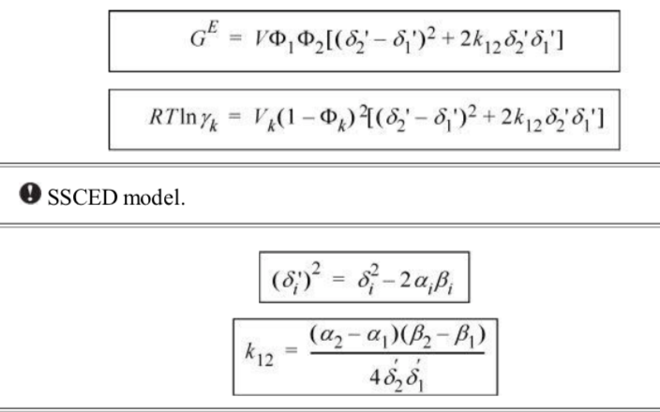

Slide 7
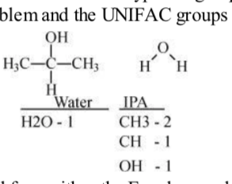
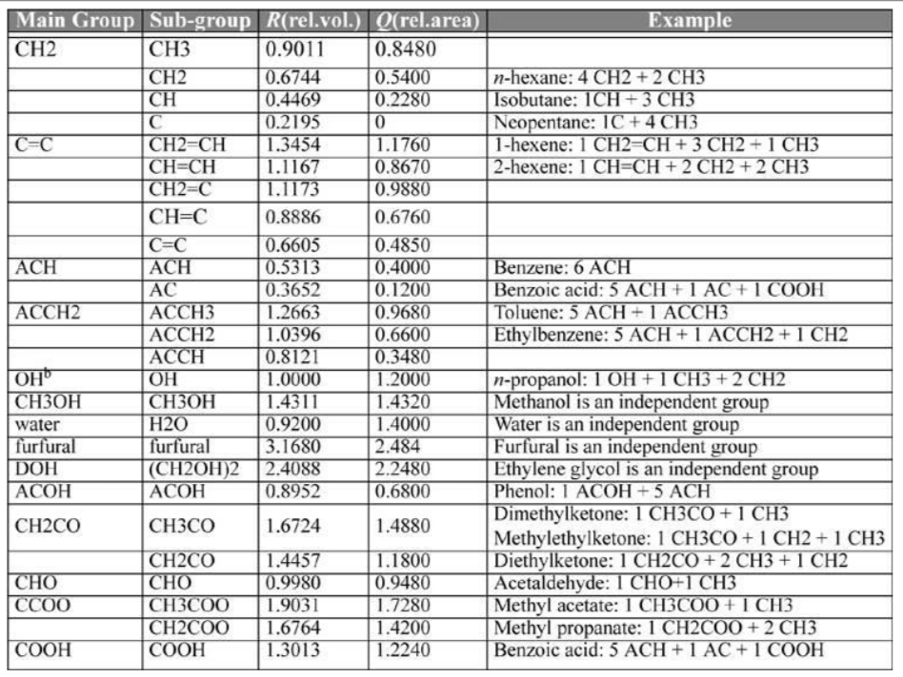

Slide 8
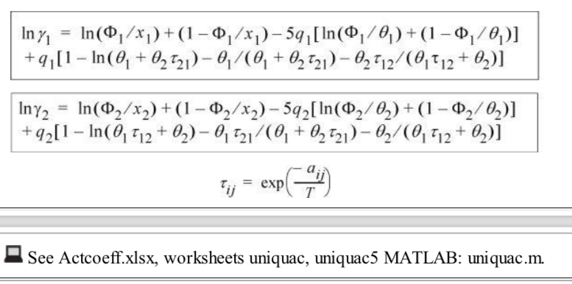
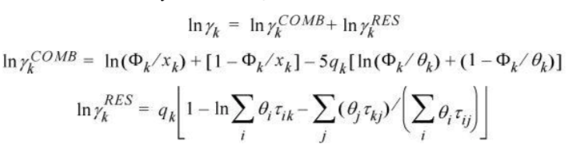

Slide 9
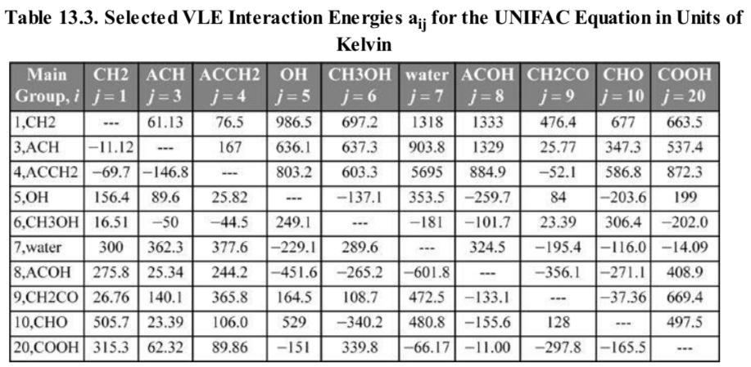

Slide 10
Important to stripping, liquid extraction, precipitation and other separation processes.

Slide 11
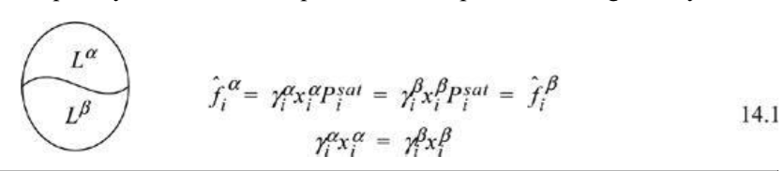
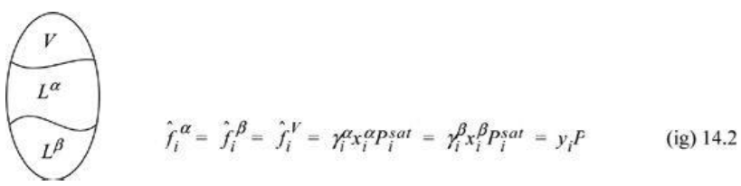

Slide 12
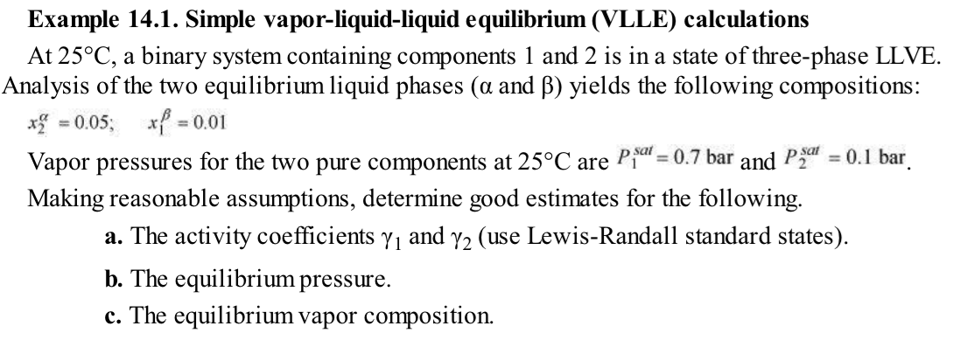
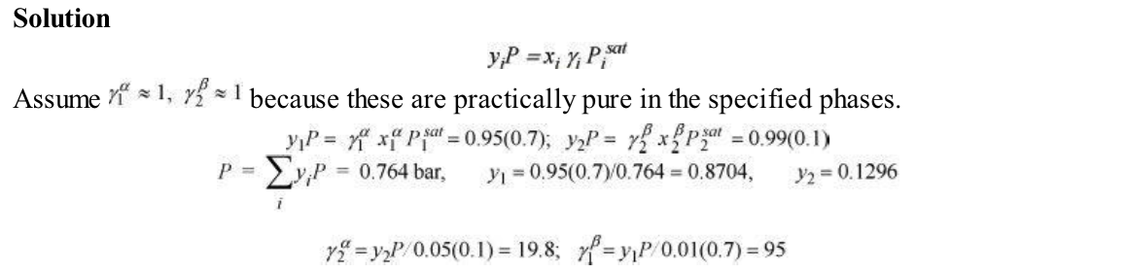

Slide 13
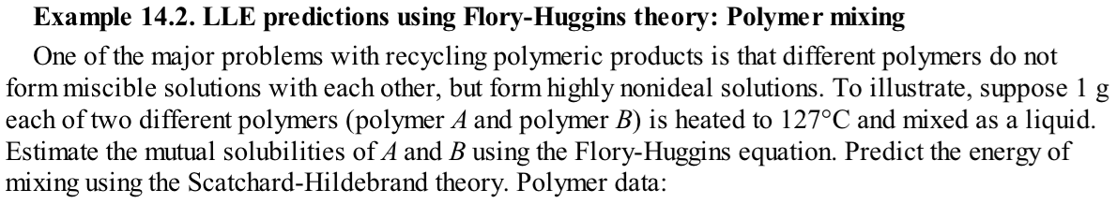
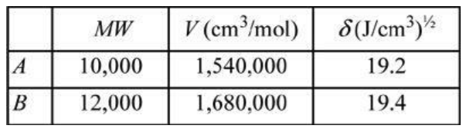

Slide 14
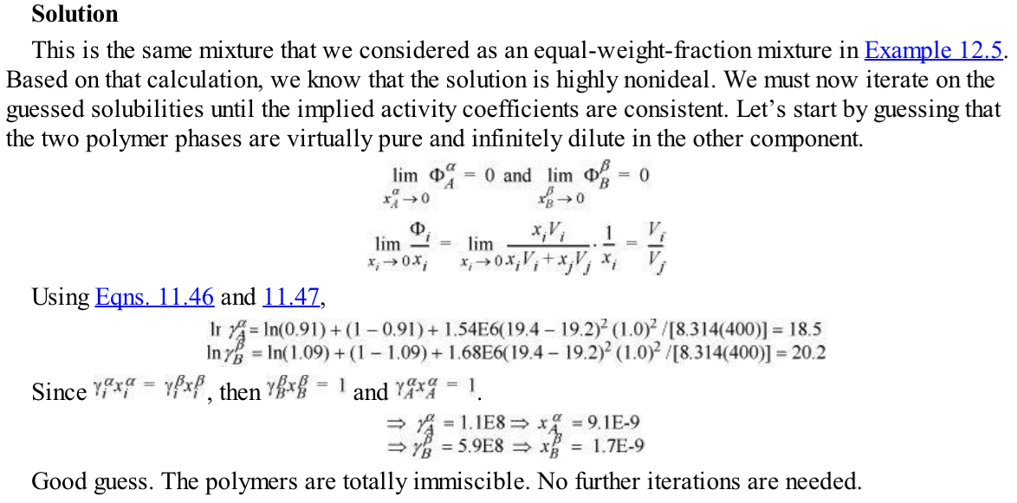
Calculate gamma
using 12.36
And zero limit
For pure x = 1 y=1 so Py = x Psat gamma
P = Psat and gamma is 1 for pure
So (x gamma) for matching phase with
pure is 1 so get x then use x and 12.36
To get gamma, then get x from 1/gamma

Slide 15
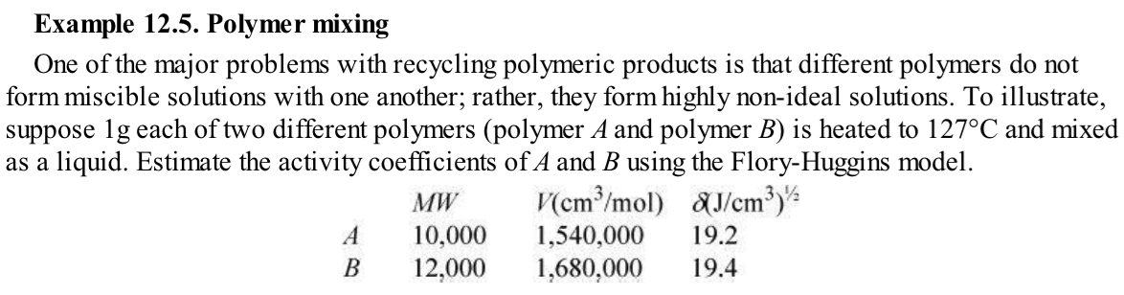
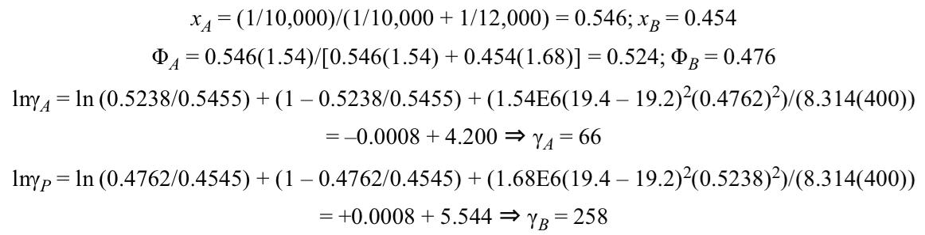

Slide 16

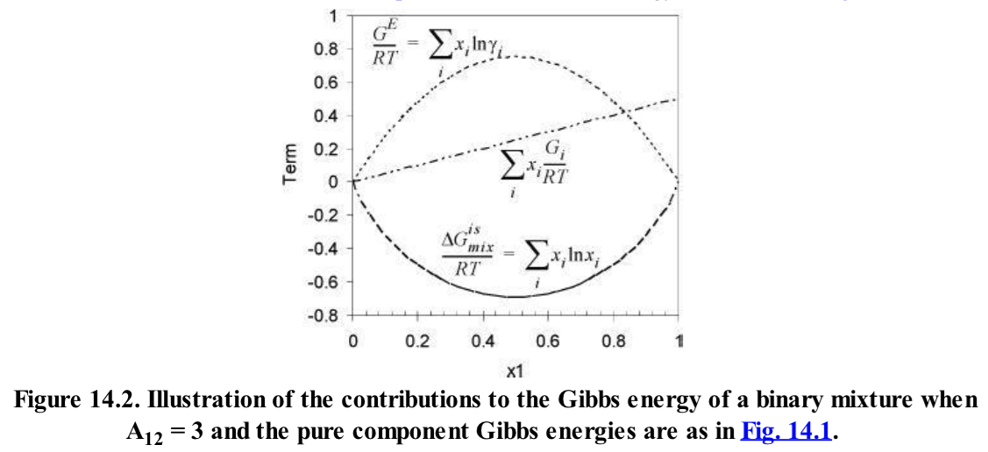

Slide 17
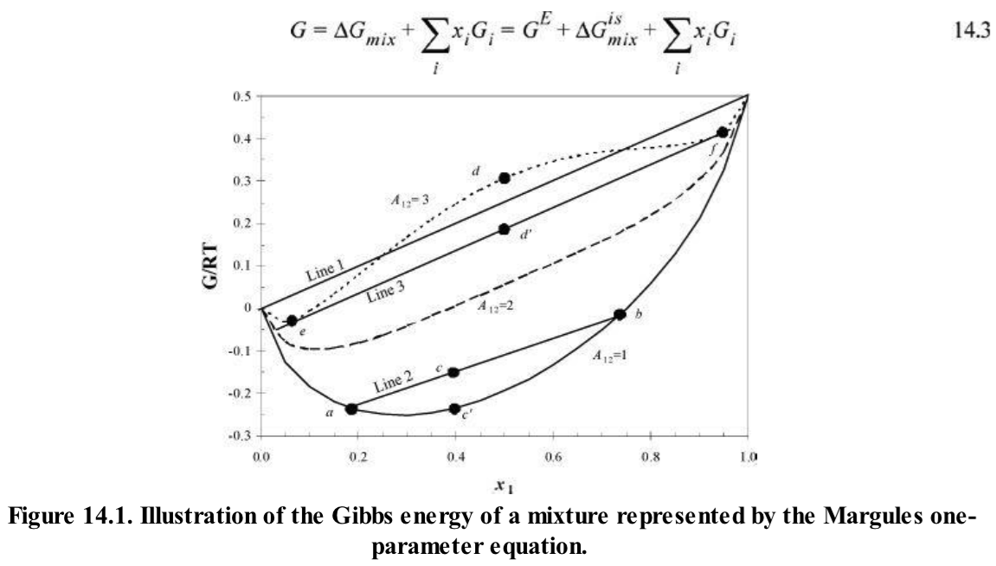

Slide 18
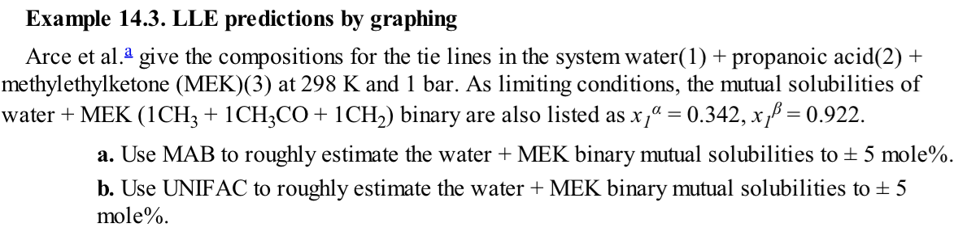
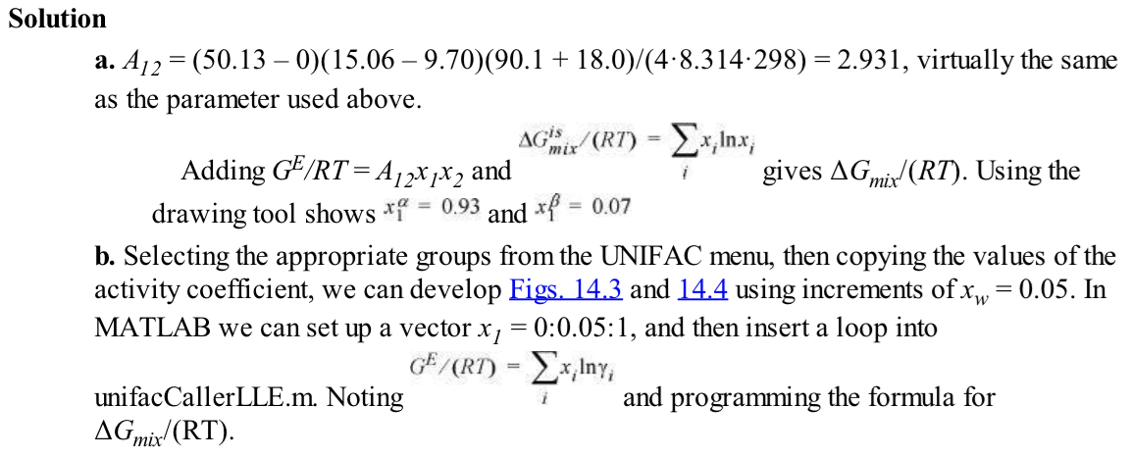

Slide 19
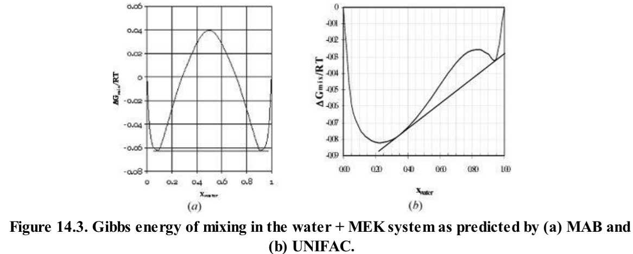

Slide 20
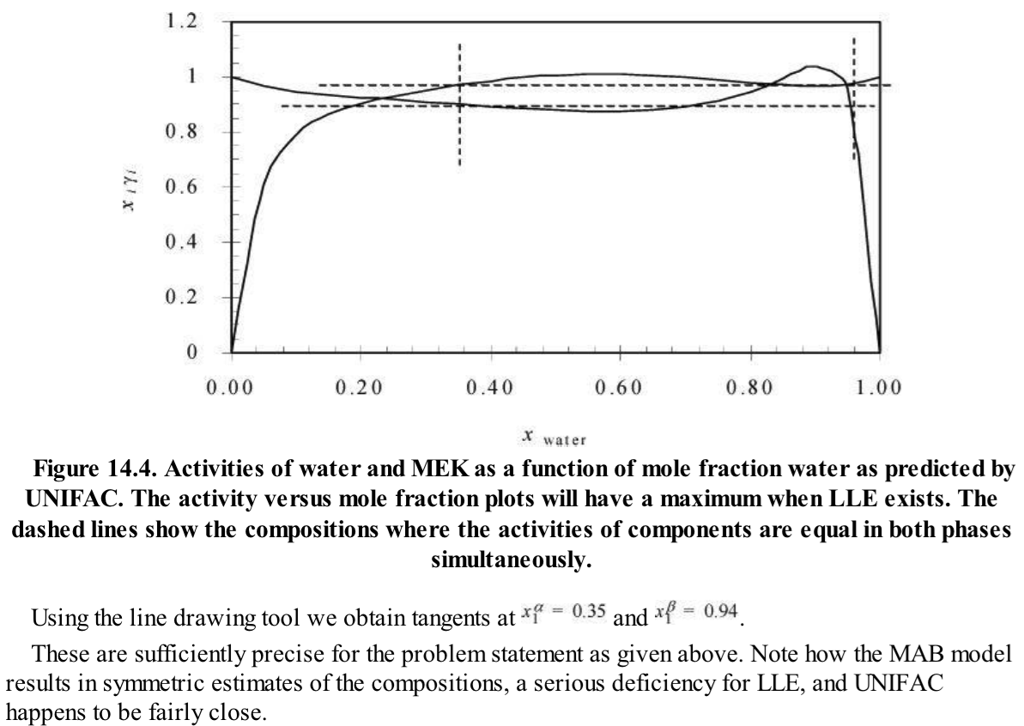

Slide 21




Activity a_{i}^{α}=a_{i}^{β}

Slide 22
Activity a_{i}^{α}=a_{i}^{β}
For ternary x₃ given

Slide 23
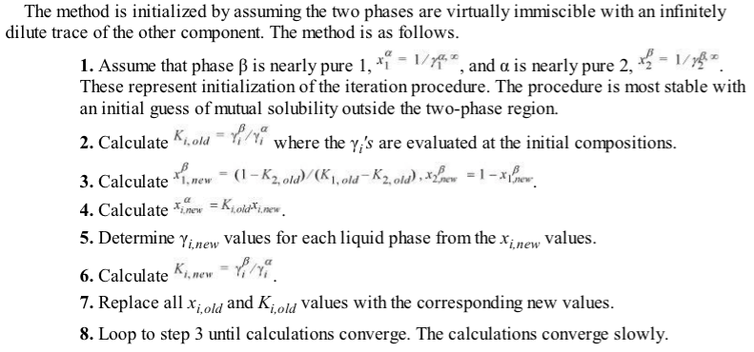
USE UNIFAC, MAB, SSCED etc.
USE UNIFAC, MAB, SSCED etc.

Slide 24



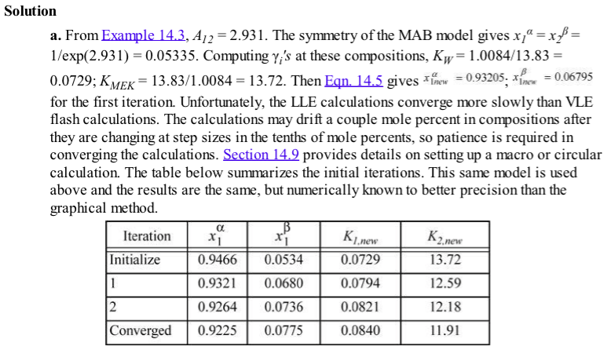

Slide 25
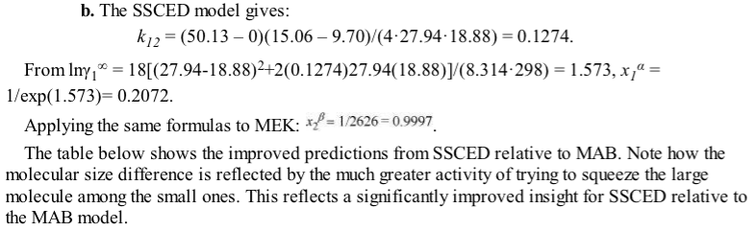
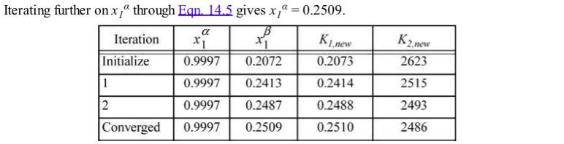

Slide 27
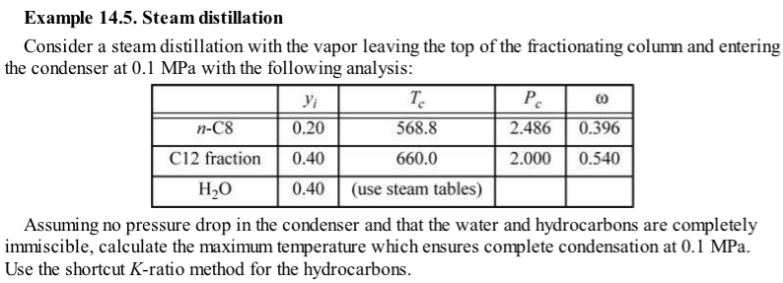


Slide 28
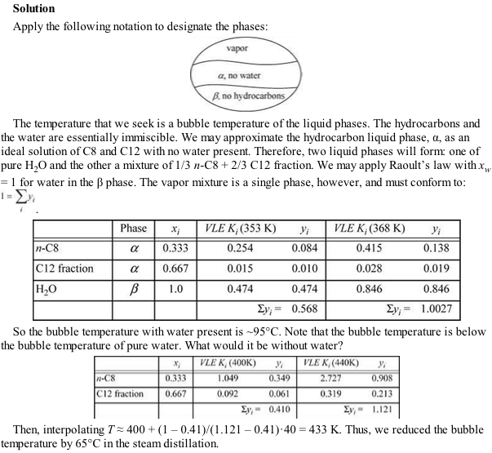
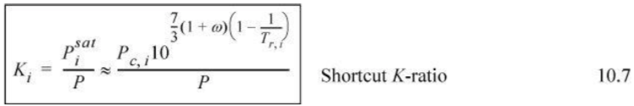

Slide 29
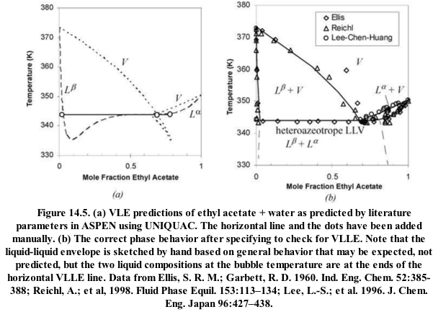
F =1 = line
F = 0 = point
F = 2 = space
Gibbs phase rule F = C – P +2

Slide 30
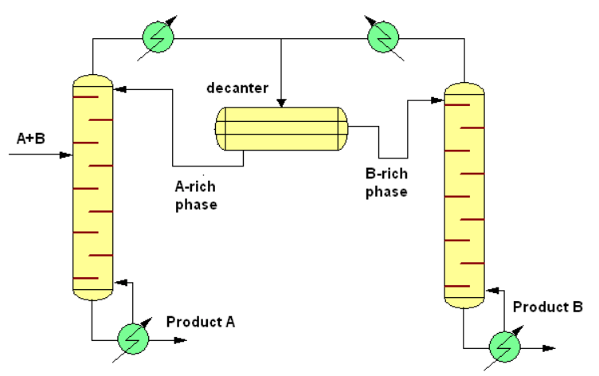
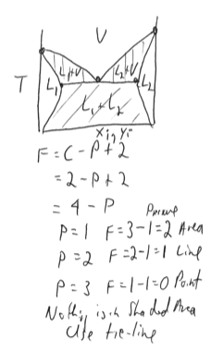
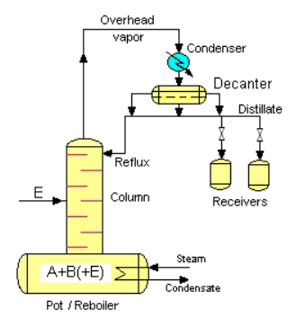
Continuous
Heteroazeotrope
Batch

Slide 31
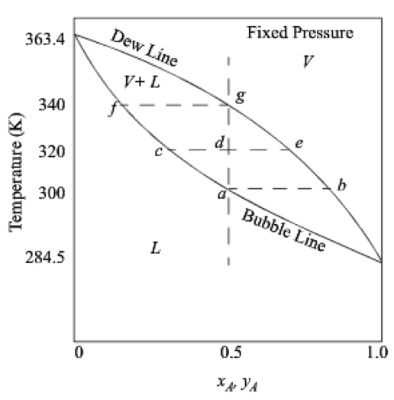
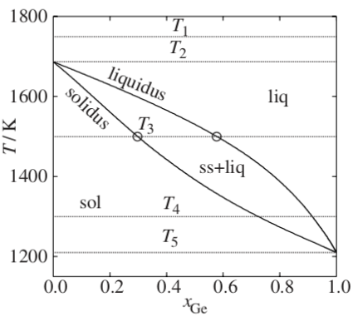
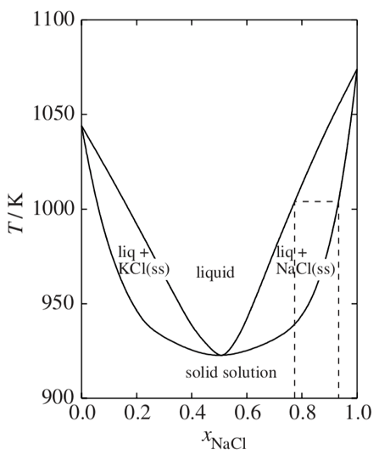
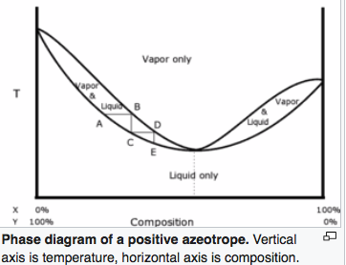
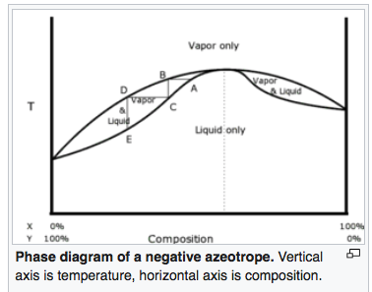
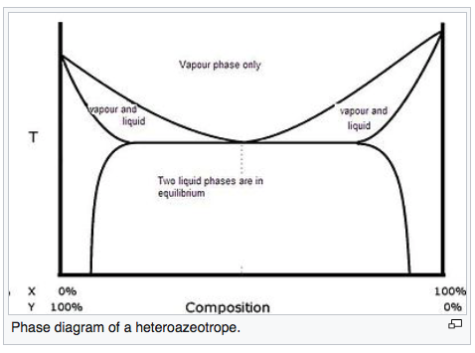
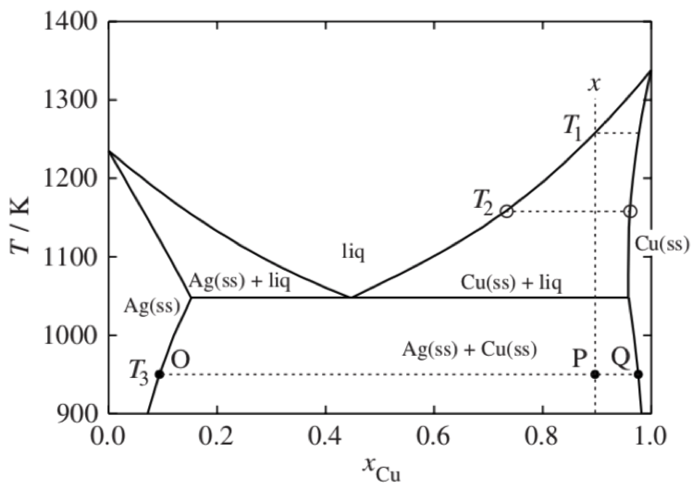
Liquid/Vapor Equilibria
Solid/Liquid Equilibria
Ideal
Ideal
L => α + L
Azeotrope
Phase diagram is split into two phase diagrams with a special composition that acts as a pure component
Non-Ideal
Congruent melting solid solution
L => α
Same crystallographic structure in solid solution phase
Heteroazeotrope
Eutectic
L => α + β
Different crystallographic structures in solid solution phases

Slide 32
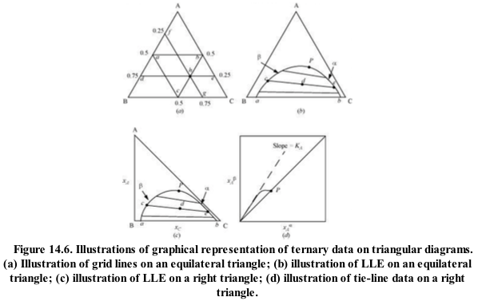
Each plot is for a fixed T and P

Slide 33
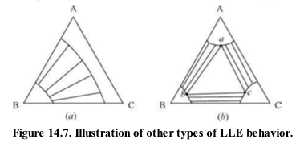

Slide 34


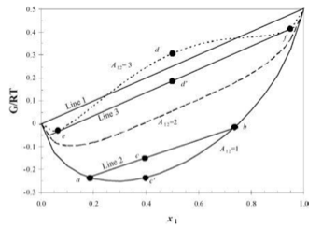
A₁₂ = a + b/T

Slide 35
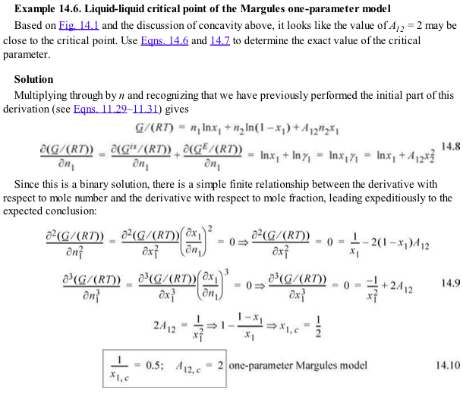

Slide 37
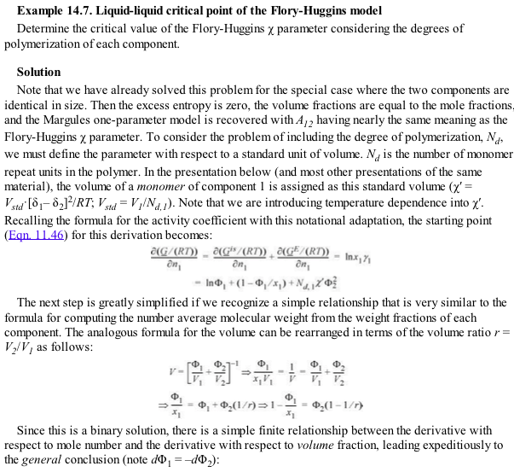



Slide 38



Slide 39




Slide 40


Slide 41


Slide 42





Slide 43


Slide 44




SSCED p. 482

Slide 45

Ice/salt melting point depression

Slide 46





Slide 47

UNIFAC .xls

Slide 48





Slide 49


Slide 50


Slide 51


Slide 52


Slide 53


Slide 54


Slide 55



Slide 56

See Wax.xlsx

Slide 57


Slide 58




pp 14.3
a’s are Van der Waals constants

Slide 59



Slide 60


Slide 61


Slide 62




Slide 63



Slide 64


Slide 65



Slide 66





Slide 67


Slide 68


Slide 69




Slide 70


